Slide 1
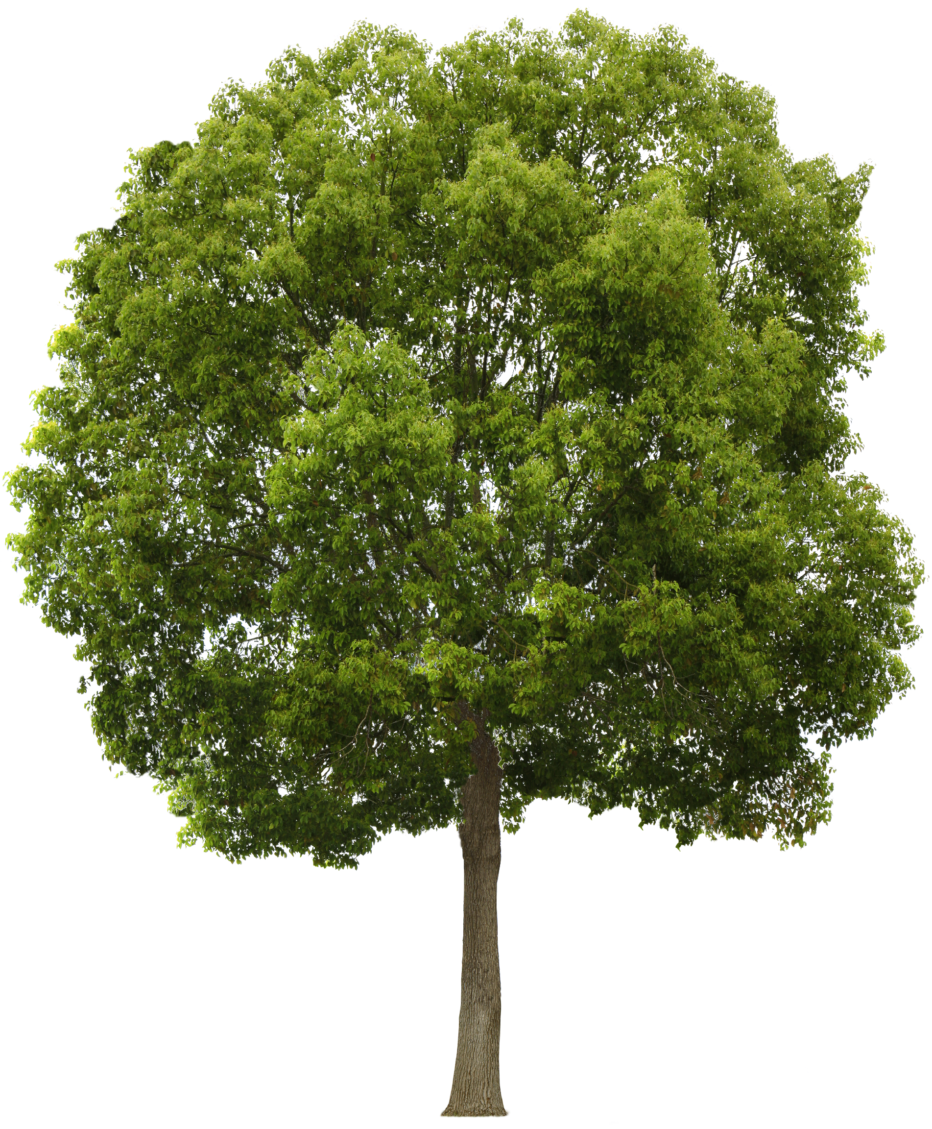
Tree Power
Powering IoT Sensor Networks with
Harvested Energy From Trees
James Stevens & Nick Purcell

Slide 2
Problem
Powering Remote Electronics with Renewable Natural Energy
Often the canopy blocks sun and the foliage blocks wind.
Alternative sources must be found

Slide 3
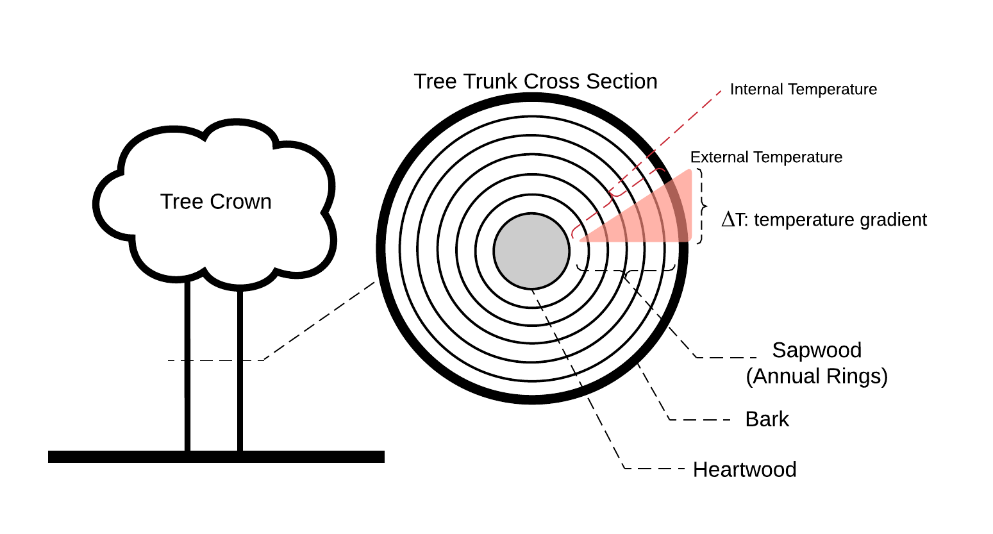
Solution / Theory
Trees attempt to maintain a 70° internal temperature
Seebeck Effect

Slide 4
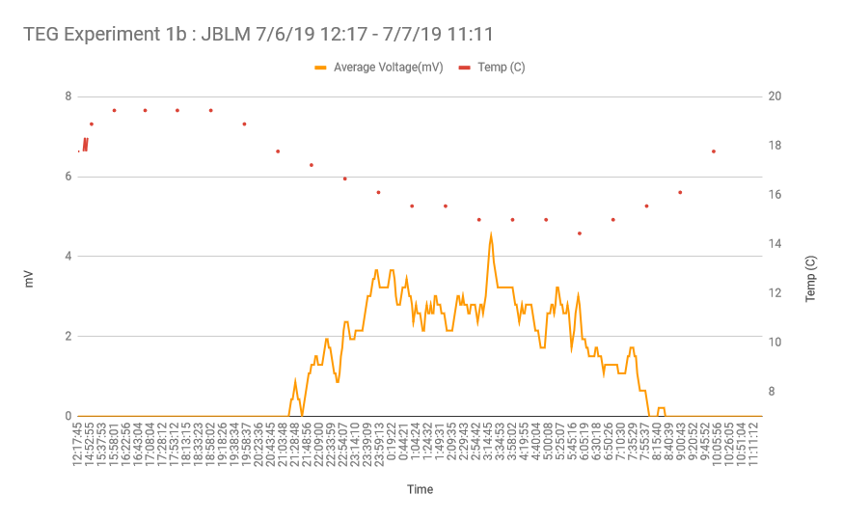
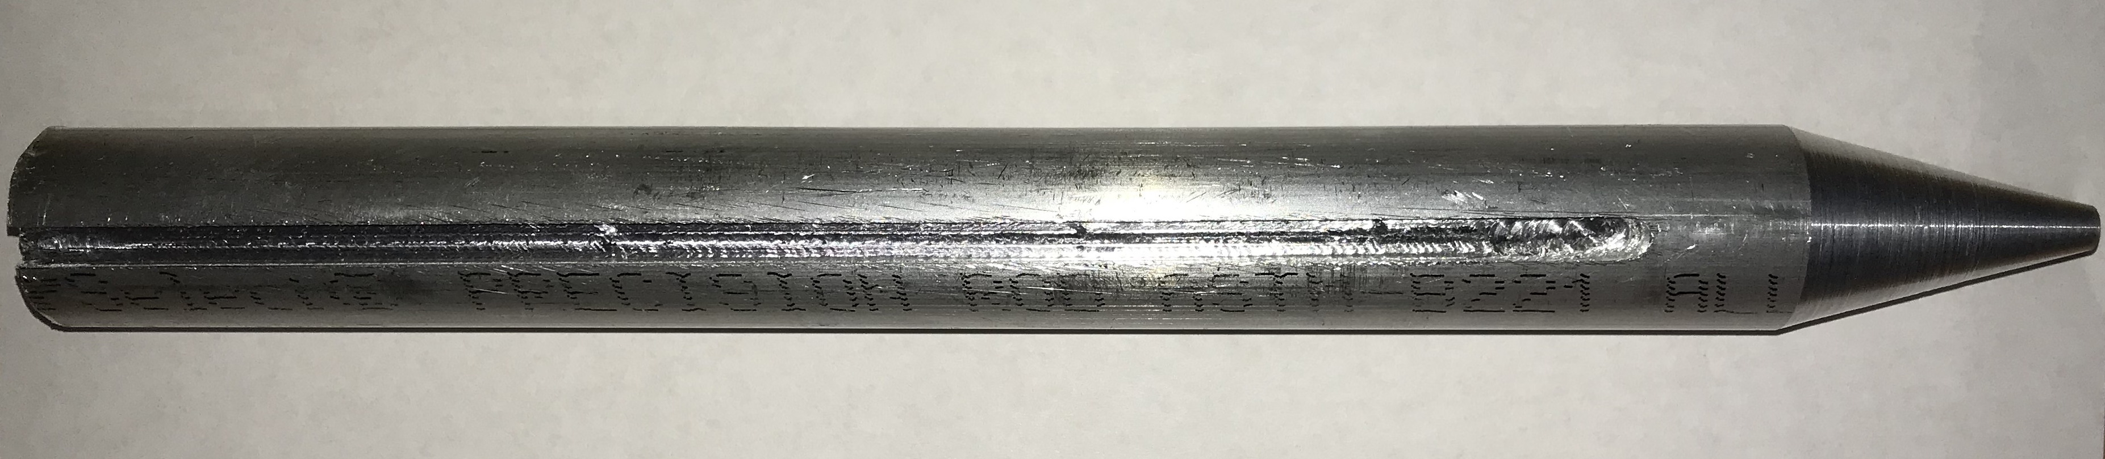
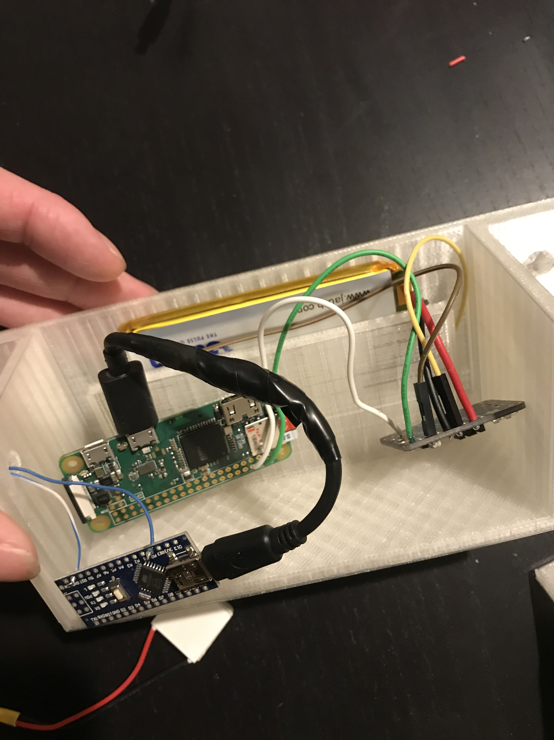
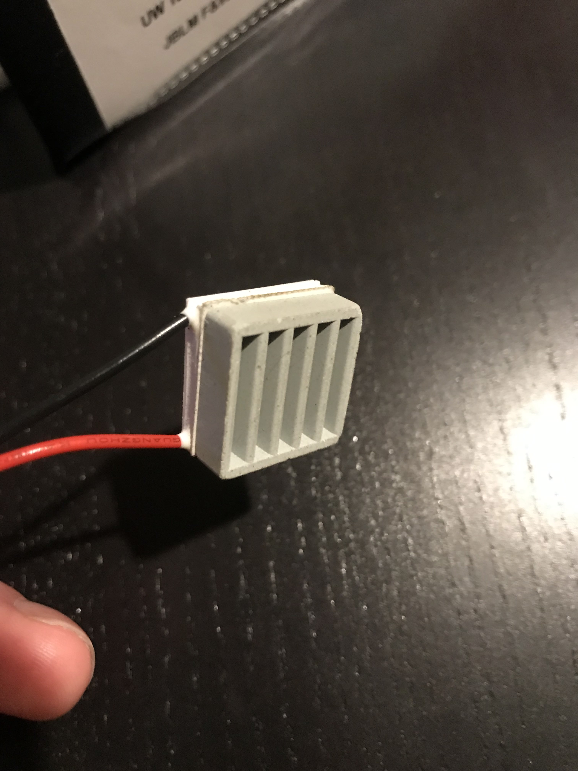
Experiment 1
Ran for ~9 Hours
18:00 – 03:00
~ 2 mV
~ 7 Hours

Slide 5
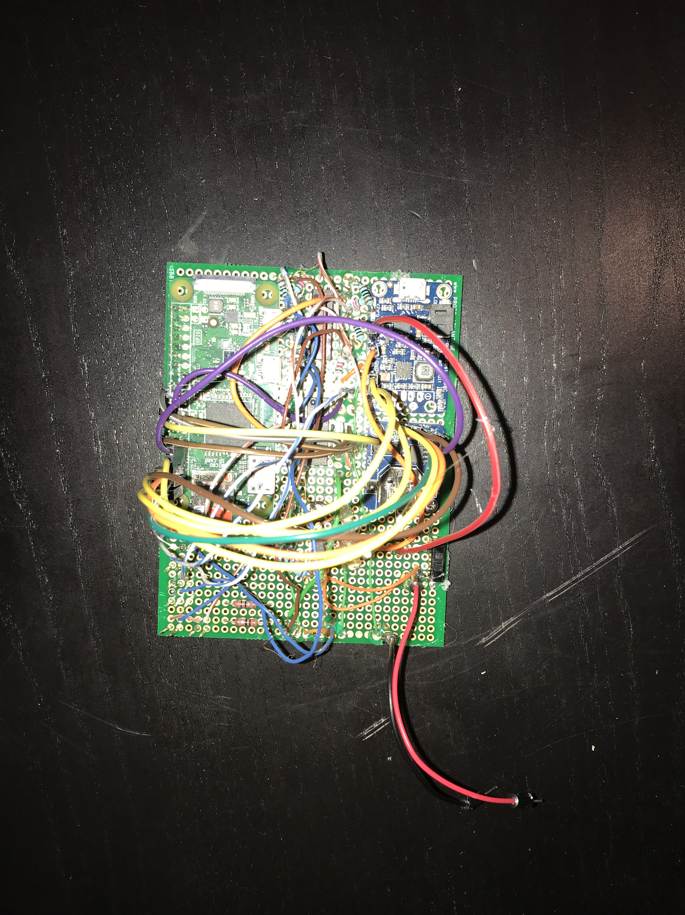
Experiment 2
Ran for ~9 Hours
18:00 – 03:00
~ 2 mV
~ 7 Hours

Slide 6
Future Experiments

Slide 7
Conclusion

